Slide 1

Using eBPF within your Python program using EBPFCat
Martin Teichmann
Spectroscopy and Coherent Scattering (SCS) Instrument
European XFEL
Notes:
Notizen durch Klicken hinzufügen

Slide 2
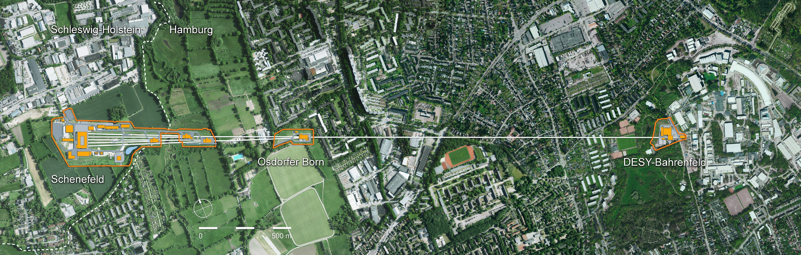
The world’s largest X-Ray laser
Publicly funded research facility
Located in Hamburg, Germany
Notes:
Notizen durch Klicken hinzufügen

Slide 3
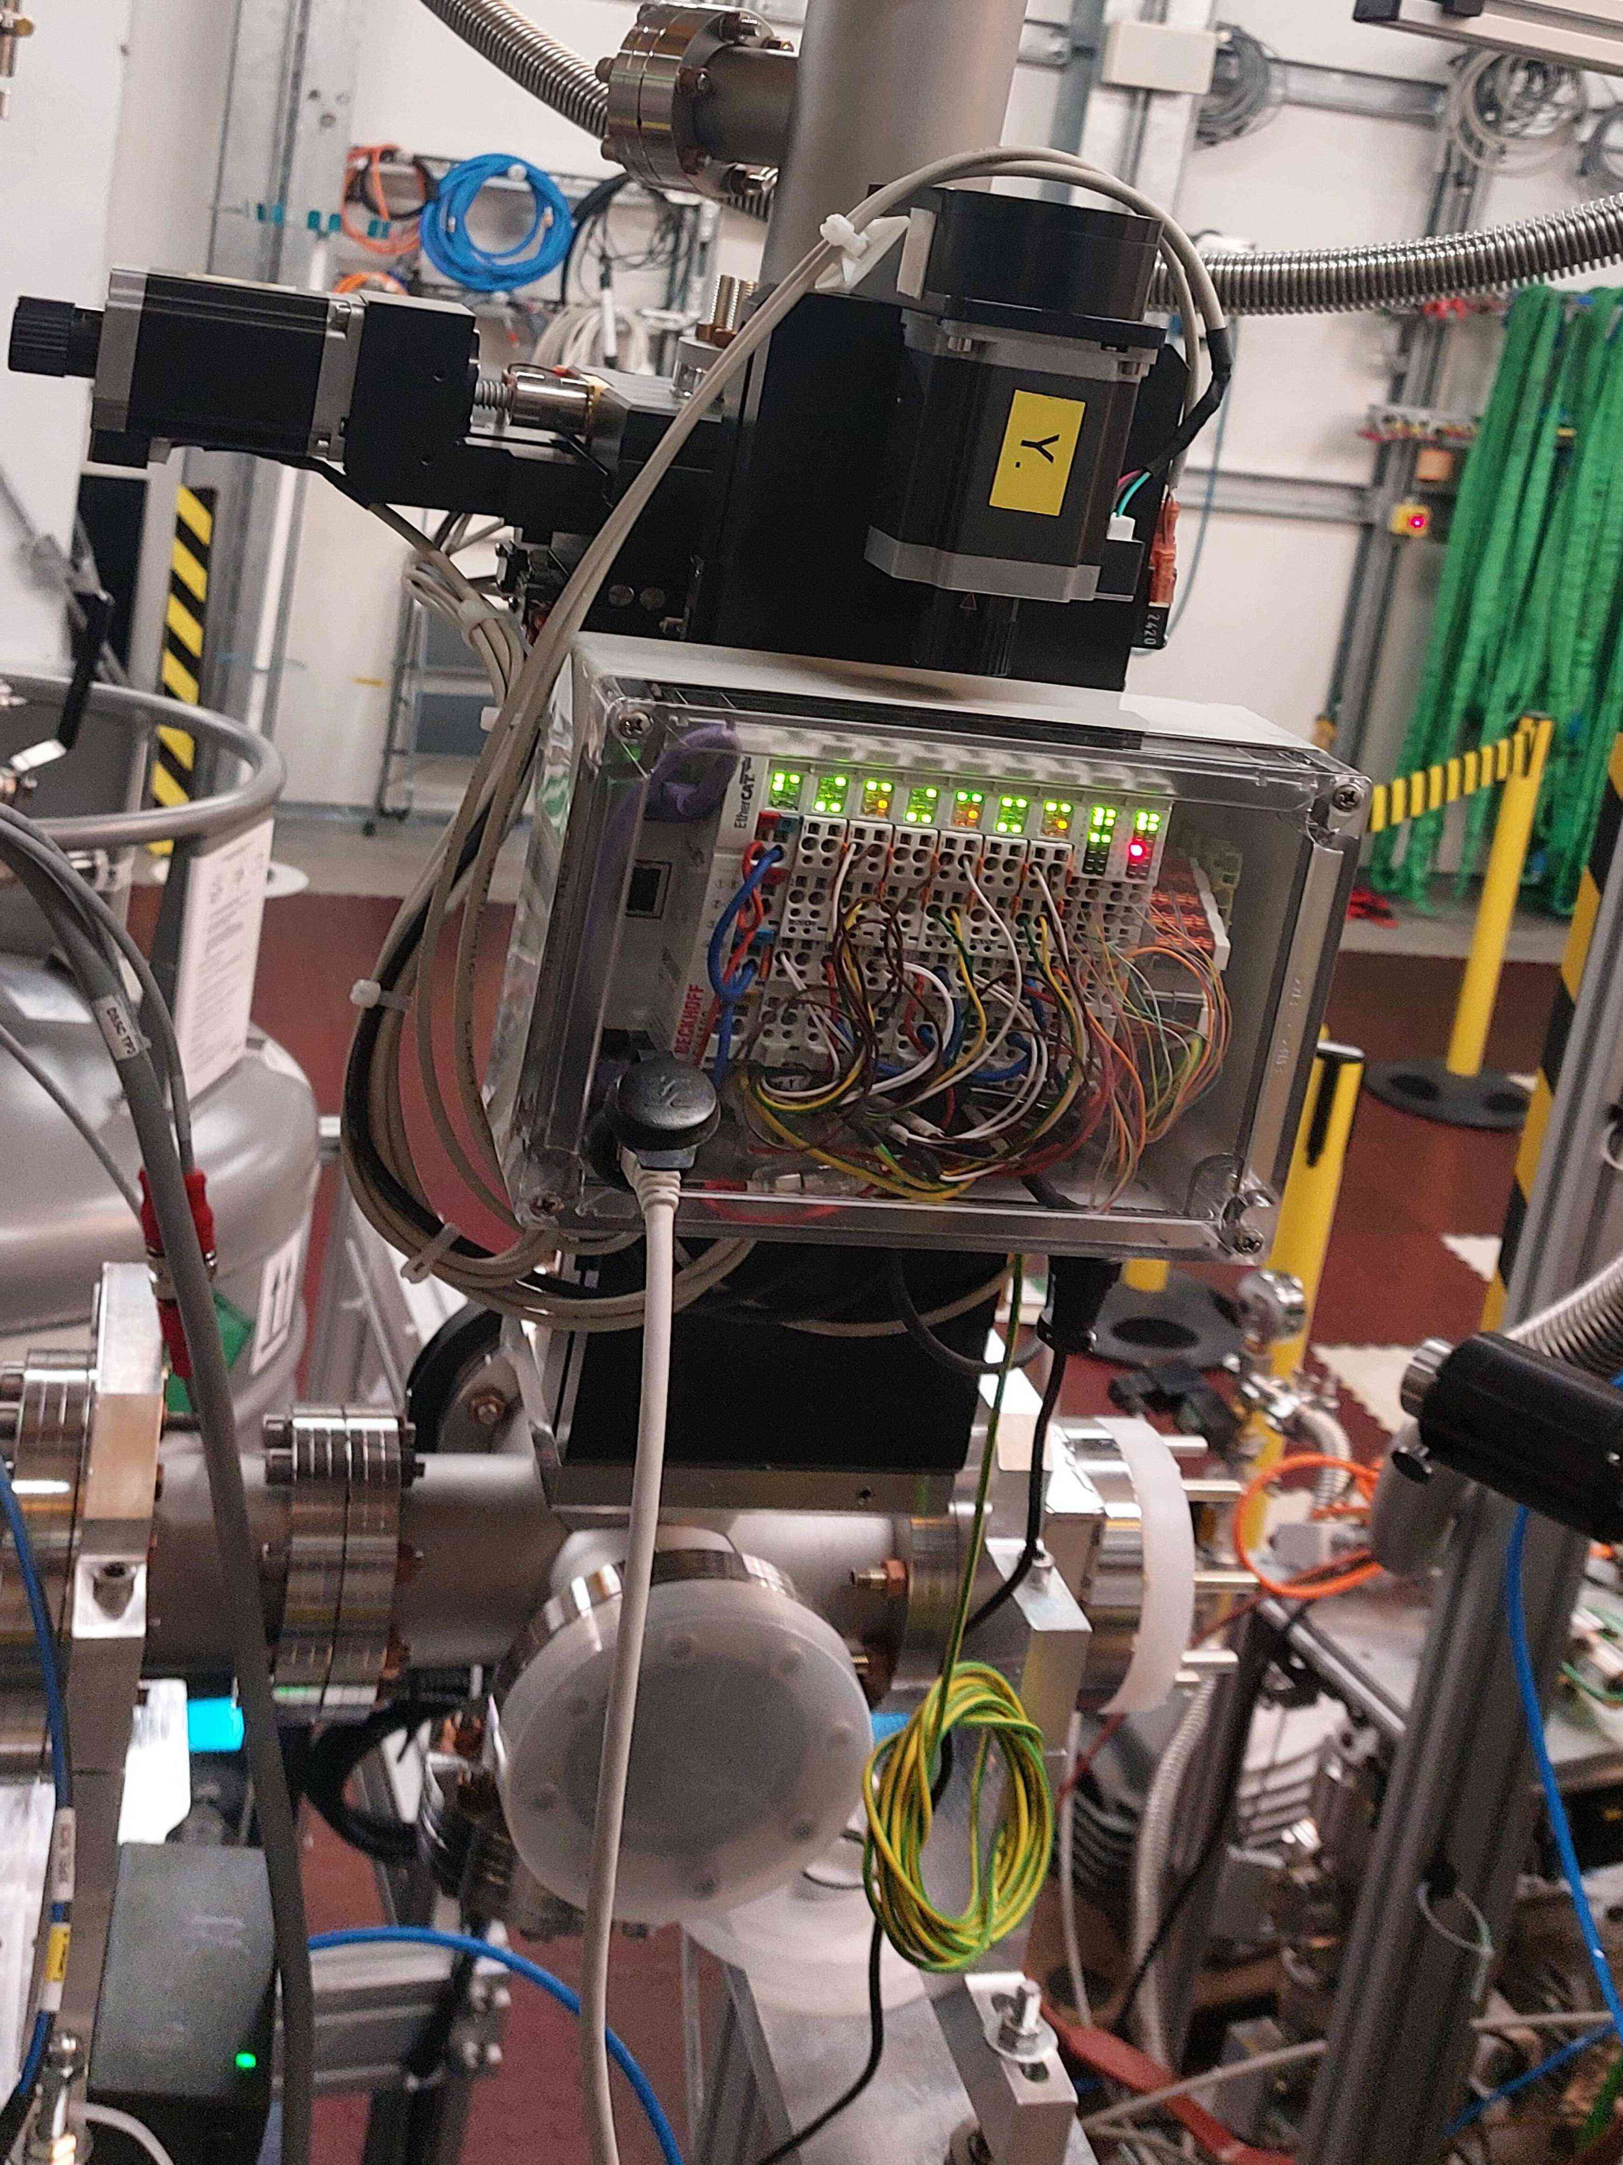
The Electron Birefringent Polarization Focus (eBPF)
In our large scientific facility, many small machines need to be automated
The automation is often done by scientists, not engineers
The EtherCAT bus system used at the European XFEL is flexible enough to allow for this
The software, however, is not. And it is not open source.
=> write a open source EtherCAT software driver flexible enough to used by users directly, while retaining all advantages of EtherCAT
Notes:
Notizen durch Klicken hinzufügen

Slide 4
How does EtherCAT work?
EtherCAT terminals
CPU
(just a normal computer)
Outer world
EtherNet packets
EtherCAT uses normal EtherNET packets, which are handed from terminal to terminal, at the end returning at the beginning.
The terminals are able to modify the packet on-the-fly in order to send data to the computer
Notes:
Notizen durch Klicken hinzufügen

Slide 5
eBPF-based control
Python controller
EtherCAT terminals
Outer world
User level
Linux kernel level
eBPF virtual machine
EtherNet network driver via XDP
The EBPF generator in EBPFCat may also be used for other EBPF use cases
We can inject a computer control loop directly into the kernel.
Notes:
Notizen durch Klicken hinzufügen

Slide 6
Topic of this talk
  How to use EBPFCat for XDP programs with simple examples
    (XDP is the eBPF program type for processing network packets)
  How it actually works
  Going through some eBPF features already supported
  Show EtherCat motion as a cool application for eBPF
Notes:
Notizen durch Klicken hinzufügen

Slide 7
Constraints
Highly Dynamic
  The layout of the EtherNet packets is only known at run time
  Even the necessary logic may only be discovered at run time
  several eBPF programs run in parallel
  The programs may be replaced at run time
Simplicity
  The programs are written by scientists with little programming experience
Flexibility
  The code should be generic, not limited to our particular problem
  EBPFCat can be used as a speed boost for normal Python programs
Notes:
Notizen durch Klicken hinzufügen

Slide 8
A simple example
from asyncio import run, sleep
from ebpfcat.arraymap import ArrayMap
from ebpfcat.xdp import XDP, XDPExitCode
class Counter(XDP):
license = "GPL"
userspace = ArrayMap()
count = userspace.globalVar()
def program(self):
self.count += 1
self.exit(XDPExitCode.PASS)
async def main():
c = Counter()
async with c.run("eth0"):
for i in range(10):
await sleep(0.1)
print("number of packets:", c.count)
if __name__ == "__main__":
run(main())
Just count the number of packets arriving
Code looks like normal Python code
the Python code generates eBPF code: there is no compilation!
Notes:
Notizen durch Klicken hinzufügen

Slide 9
A simple example
from asyncio import run, sleep
from ebpfcat.arraymap import ArrayMap
from ebpfcat.xdp import XDP, XDPExitCode
class Counter(XDP):
license = "GPL"
userspace = ArrayMap()
count = userspace.globalVar()
def program(self):
self.count += 1
self.exit(XDPExitCode.PASS)
async def main():
c = Counter()
async with c.run("eth0"):
for i in range(10):
await sleep(0.1)
print("number of packets:", c.count)
if __name__ == "__main__":
run(main())
This generates eBPF
Notes:
Notizen durch Klicken hinzufügen

Slide 10
A simple example
from asyncio import run, sleep
from ebpfcat.arraymap import ArrayMap
from ebpfcat.xdp import XDP, XDPExitCode
class Counter(XDP):
license = "GPL"
userspace = ArrayMap()
count = userspace.globalVar()
def program(self):
self.count += 1
self.exit(XDPExitCode.PASS)
async def main():
c = Counter()
async with c.run("eth0"):
for i in range(10):
await sleep(0.1)
print("number of packets:", c.count)
if __name__ == "__main__":
run(main())
same variable visible from eBPF and Python
Notes:
Notizen durch Klicken hinzufügen

Slide 11
Accessing the Packet
class Counter(XDP):
minimumPacketSize = 16 # keep the eBPF verifier happy
etherType = PacketVar(12, "!H") # !H from Python struct package
userspace = ArrayMap()
count = userspace.globalVar()
def program(self):
with self.etherType == 0x800: # always generate code: no if possible
self.count += 1
self.exit(XDPExitCode.PASS)
Notes:
Notizen durch Klicken hinzufügen

Slide 12
Accessing the Packet
class Counter(XDP):
minimumPacketSize = 16 # keep the verifier happy
etherType = PacketVar(12, "!H")
userspace = ArrayMap()
ipv4count = userspace.globalVar()
ipv6count = userspace.globalVar()
def program(self):
with self.etherType == 0x800 as Else:
self.ipv4count += 1
with Else, self.etherType == 0x86DD: # read as: elif
self.ipv6count += 1
self.exit(XDPExitCode.PASS)
Notes:
Notizen durch Klicken hinzufügen

Slide 13
How eBPF code is generated
class Counter(XDP):
speed = PacketVar(12, "I")
userspace = ArrayMap()
max_speed = userspace.globalVar("i")
def program(self):
with self.speed > self.max_speed:
self.speed = self.max_speed
using descriptors with __get__ and __set__
1: r2 = *(u32 *)(r8 + 12)
2: r3 = *(i32 *)(r9 + 16)
3: if r3 <= r2 goto pc + 2
4: *(i32 *)(r9 + 16) = r2
Notes:
Notizen durch Klicken hinzufügen

Slide 14
Prerequisites
EBPFCat has no dependencies
  OK, technically Python 3, Linux and libc
So a simple
pip install ebpfcat
And you have a working setup
Notes:
Notizen durch Klicken hinzufügen

Slide 15
Permanent and local programs
eBPF programs used as local speedup within one Python program, with automatic cleanup at the end:
program = Program()
async with program.run("eth0"):
... # Python business logic
An eBPF program can also run independently from the running Python program, the starting program executes:
program = Program()
await program.attach("eth0")
program.pin_maps("/sys/fs/bpf/my_maps")
# some business logic
at a later time:
program = Program(load_maps="/sys/fs/bpf/my_maps")
# some more business logic
# and once finally done:
await program.detach("eth0")
Notes:
Notizen durch Klicken hinzufügen

Slide 16
Motion control with EtherCat
Read the self-description for all involved terminals
Prepare an EtherNet packet for all data to be transferred, e.g.:
Program the terminals to accept such a packet
Generate the EBPF program, and load into Linux kernel
Send prepared packets => eBPF program will cyclically process them
Execute slow Python code for communication with outside world
Header
Encoder position
Motor speed
Limit switches
1: r2 = *(u32 *)(r1 + 12)
2: r3 = *(i32 *)(r9 + 16)
3: if r3 <= r2 goto pc + 2
4: *(i32 *)(r9 + 16) = r2
with self.speed > self.max_speed:
self.speed = self.max_speed
Notes:
Notizen durch Klicken hinzufügen

Slide 17
dispatching on packet content
A permanent program with a pinned PROG_ARRAY map
Packets contain breadcrumbs for dispatching
tail_call into the specific program
Incoming Packet:
PROG_ARRAY
Monitor program
Motion program
Vacuum program
Header
bread crumb
Encoder position
Motor speed
Limit switches
A local program picks up its data
class Motion(XDP):
...
Notes:
Notizen durch Klicken hinzufügen

Slide 18
Programming a motor
Python allows us to write very high level code:
class Motor(Device):
velocity = TerminalVar() # communication with the hardware
encoder = TerminalVar()
target = DeviceVar() # communication with the user
proportional = DeviceVar()
def program(self):
self.velocity = (self.target – self.encoder) * self.proportional
Notes:
Notizen durch Klicken hinzufügen

Slide 19
Summary
EBPFCat can generate eBPF code from Python
It can be used generically to write eBPF programs, especially XDP programs
As a special case it can be used for computer control of EtherCAT compatible hardware
Everything can be found at
https://github.com/tecki/ebpfcat
Documentation at
https://ebpfcat.readthedocs.io/en/latest/
Bonus material for the really interested:
https://git.xfel.eu/karaboDevices/karahoff
Thanks to the SCS group at the European XFEL, Carsten Broers and Jan Tolkiehn for the hardware,
Tobias Freyermuth for useful discussions
Notes:
Notizen durch Klicken hinzufügen

Slide 20
Thank you!
Thanks to my group SCS at European XFEL
Notes:
Notizen durch Klicken hinzufügen

Slide 21
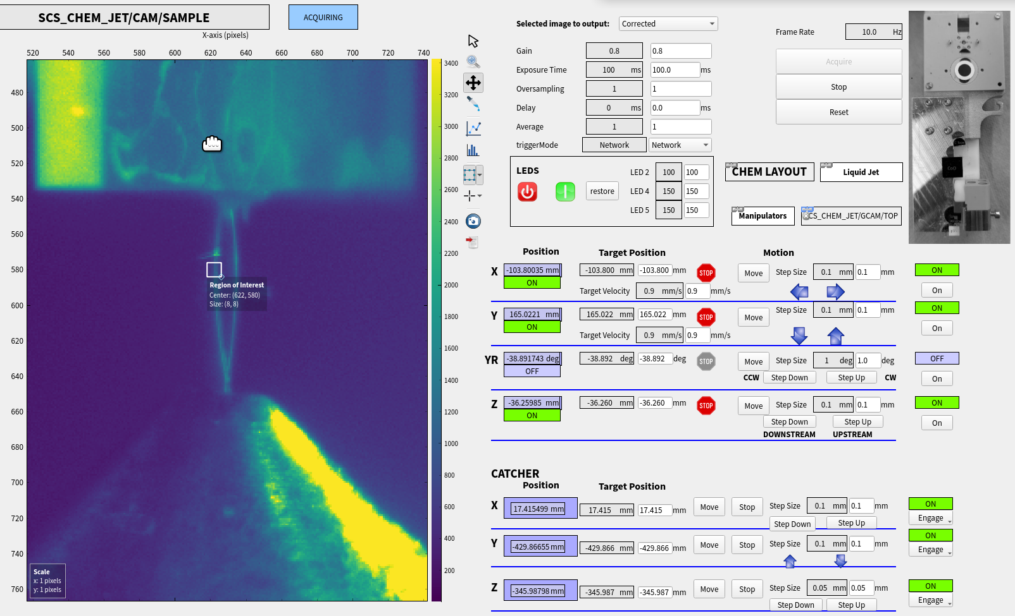
Example: parallel motion
A liquid jet is injected into a vacuum chamber, and pumped out by a catcher system
The two systems are moved by independent motors, we lock the motor movement between them using EBPFCat
Everything here is user-generated, no experts are needed
Notes:
Notizen durch Klicken hinzufügen

Slide 22
class MotorDevice(Device):
velocity = TerminalVar()
encoder = TerminalVar()
low_switch = TerminalVar()
high_switch = TerminalVar()
enabled = TerminalVar()
control_word = TerminalVar()
reduced_current = TerminalVar()
stepcounter = TerminalVar()
encoder_error = TerminalVar()
set_control_word = DeviceVar('H')
deadband_exceeded = DeviceVar('b')
max_velocity = DeviceVar('q')
last_velocity = DeviceVar('q')
max_acceleration = DeviceVar('Q')
deadband = DeviceVar('q')
target = DeviceVar('q')
proportional = DeviceVar('q')
lasttime = DeviceVar('Q')
velocity_diff = LocalVar('q')
def calculate_speed(self):
self.ebpf.stmp = (self.proportional * self.ebpf.stmp) >> 16
def program(self):
with self.ebpf.tmp:
self.ebpf.tmp = ktime(self.ebpf)
self.velocity_diff = (self.max_acceleration
* (self.ebpf.tmp - self.lasttime)) >> 32
with self.velocity_diff > 0 as Else:
self.lasttime = self.ebpf.tmp
self.control_word = self.set_control_word
with abs(self.target - self.encoder) > self.deadband as Else:
if self.reduced_current is not None:
self.reduced_current = False
self.deadband_exceeded = 1
if self.reduced_current is not None:
with Else:
self.reduced_current = True
with self.ebpf.stmp:
self.ebpf.stmp = self.target - self.encoder
self.calculate_speed()
with self.ebpf.stmp > self.max_velocity:
self.ebpf.stmp = self.max_velocity
with self.ebpf.stmp + self.max_velocity < 0:
self.ebpf.stmp = -self.max_velocity
if not self.isLimitless:
with ((self.low_switch != 0) & (self.ebpf.stmp < 0)):
self.ebpf.stmp = 0
with ((self.high_switch != 0) & (self.ebpf.stmp > 0)):
self.ebpf.stmp = 0
if self.encoder_error is not None:
with self.encoder_error:
self.ebpf.stmp = 0
self.velocity = self.ebpf.stmp
with self.ebpf.stmp > self.last_velocity + self.velocity_diff as Else:
self.velocity = self.last_velocity + self.velocity_diff
with Else, self.last_velocity > self.ebpf.stmp + self.velocity_diff:
self.velocity = self.last_velocity - self.velocity_diff
with self.enabled as Else:
self.last_velocity = self.velocity
with Else:
self.last_velocity = 0
class FollowerDevice(MotorDevice):
follow_offset = DeviceVar('q')
doFollow = DeviceVar('B')
def calculate_speed(self):
super().calculate_speed()
with (self.doFollow != 0) & (self.leader.device.enabled != 0):
self.ebpf.stmp += (int(self.motors_factor * self.follow_factor
* (1 << 16)) * self.leader.device.velocity) >> 16
def program(self):
with self.doFollow != 0:
self.target = ((self.leader.device.encoder
* int(self.follow_factor * (1 << 16))) >> 16) \
+ self.follow_offset
with abs(self.target - self.encoder) > self.follow_lag:
self.set_control_word = self.SWITCH_OFF
self.doFollow = 0
self.leader.device.set_control_word = \
self.leader.SWITCH_OFF
super().program()
The Code for parallel motion
Notes:
Notizen durch Klicken hinzufügen

Slide 23
The building blocks of EBPFCat
Terminals are the hardware actually connected to the EtherCAT bus
Devices are hardware controlled by the terminals that logically belong together
Sync Groups are units that run independently - even in different tasks so even their code can be modified on-the-fly
Motor Terminal M1
Device Motor 1
Encoder Terminal E12
Device Motor 2
Motor Terminal M2
Sync Group 1
Analog Input 1
Pressure Gauge
Digital Output 1
Valve
Digital Input 1
Sync Group 2
Notes:
Notizen durch Klicken hinzufügen

